Slide 1
East Sussex Prosperity
What it means for your business
Alistair Wickens Impactology Ltd ·
Mark Beaumont Lanoguard Ltd
Business East Sussex · Team East Sussex
1 / 8

Slide 2
Three challenges. Twenty-five years.
Productivity
Earnings
House prices
73%
~90%
13×
of UK average GVA per job
of UK average workplace pay
vs local earnings (Wealden)
2 / 8
Mike Lawrence

Slide 3
A strategy for business, people and place
For Business
For People
For Place
Scale-up support
Employment land
Networks
Innovation
Higher-value investment
Retain young people
Career pathways
Skills matching
Housing affordability
Ageing workforce
Environmental assets
Hastings & Bexhill
Cultural opportunity
Connectivity
All areas thriving
Strategy approved October 2024 · We are here about the Investment Plan
3 / 8
Mike Lawrence

Slide 4
A once-in-a-generation moment
Devolved investment fund
Already released
People covered
£1.14bn
£30.4m
1.7m
over 30 years
first two years
Sussex & Brighton combined authority
New combined authority · board met March 2026 · Investment Plan being written now · interventions subject to external funding being secured
4 / 8
Mike Lawrence

Slide 5
Where national investment is going
1
Advanced Manufacturing
2
Clean Energy Industries
Robotics · 3D printing · Aerospace
Renewables · Hydrogen · Storage
3
Creative Industries
4
Defence
Digital media · Design · Arts · AR/VR
Security · Aerospace · Dual-use tech
5
Digital & Technologies
6
Financial Services
AI · Cybersecurity · Software
Fintech · Payments · Capital markets
7
Life Sciences
8
Professional & Business
Biotech · Pharmaceuticals · Genomics
Legal · Accountancy · Management consulting
5 / 8
Mike Lawrence

Slide 6
Six things that directly affect how you operate
Skills
Sites & premises
Connectivity
Adult Skills Funding under local control
Employment land pipeline — policy shaped now
Transport & digital investment
Networks
Innovation
Recruitment
Stronger local supply chains
Scale-up & university links
Housing, cost of living, careers — one challenge
6 / 8
Alistair Wickens

Slide 7
Three things. That is all we ask.
01
02
03
Read it
Respond to it
Share it
Scan the QR code · ESCC website · executive summary is 4 pages
economic.development@eastsussex.gov.uk · what's missing, what matters most
Forward to any business leader who should be part of this
Want to play a more active part? Business East Sussex would welcome a conversation.
7 / 8
Alistair Wickens

Slide 8
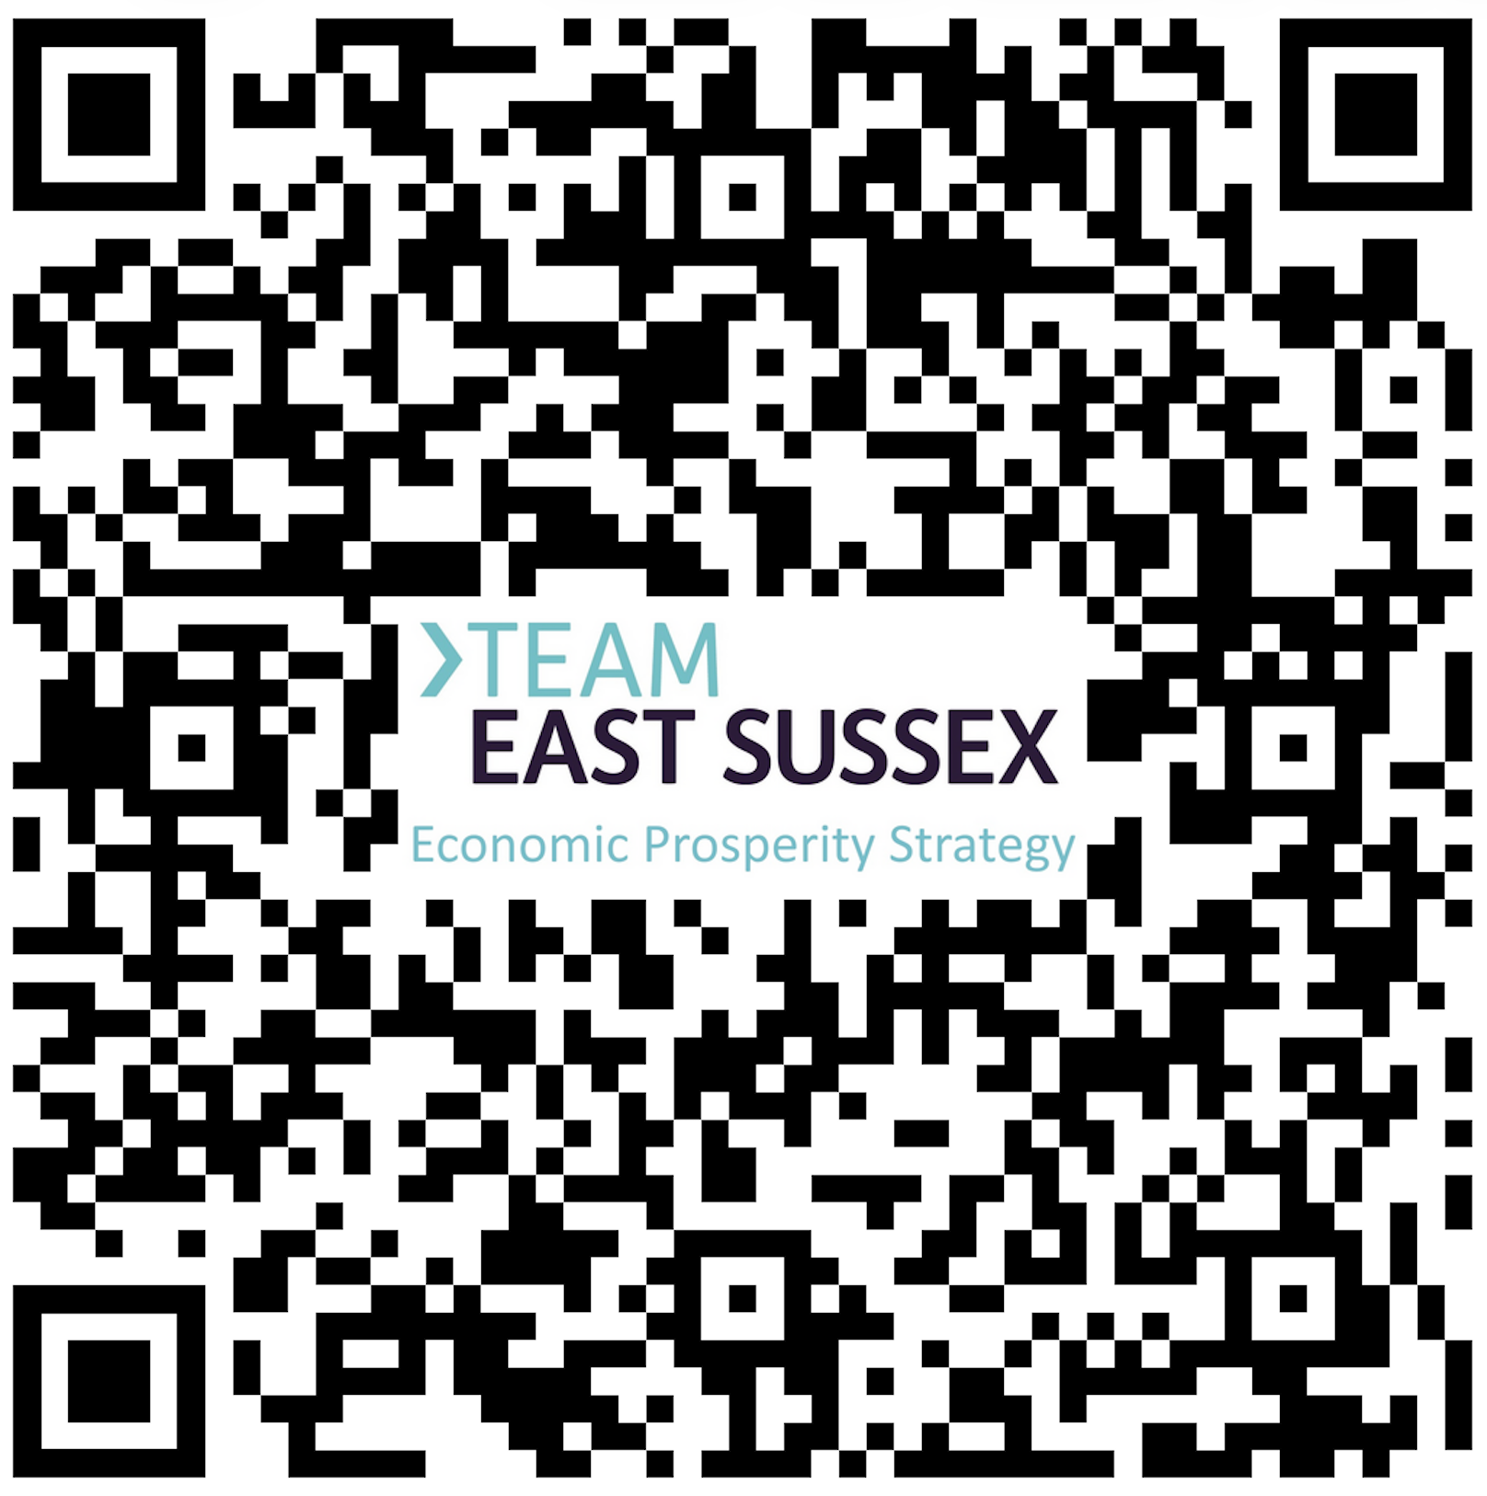
Read it. Respond to it. Shape it.
Send your feedback
[QR Code]
economic.development@eastsussex.gov.uk
Your input informs the Investment Plan —
the specific interventions being prioritised now.
Alistair Wickens Impactology · Mike Lawrence Global WealthMap
Business East Sussex · Team East Sussex
Scan to read the strategy
8 / 8

