Slide 1
Update from Sussex and Brighton Strategic Authority
September 2026
Notes:
Layout: 01 Cover
Replace the title, subtitle, presenter/team and date. Delete optional fields if unnecessary. Keep the supplied wordmark unchanged. The title supports two lines.

Slide 2
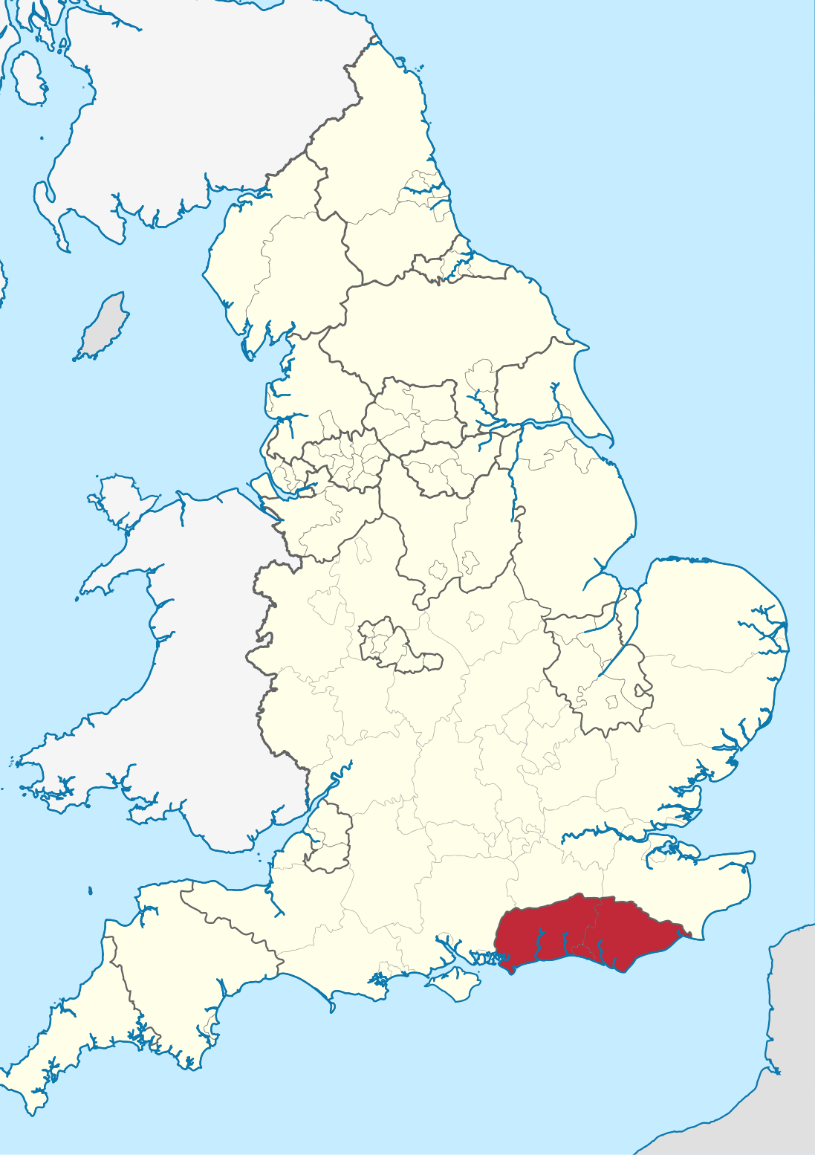
Who are we?
West Sussex County, East Sussex County and Brighton & Hove City Councils have come together to form the Sussex & Brighton Strategic Authority (SBSA).
It is a new body that will provide regional leadership over issues better undertaken at scale, such as transport, housing, infrastructure, jobs, public safety and the environment.
It will give Sussex a strong, unified voice at a national and international level to unlock new powers, funding and investment from government and the private sector.
Strategic authorities are led by a Board of constituent councils and partners. Sussex is likely to have a Mayor elected in 2028.
Notes:
Layout: 04 Standard content
Use a short headline and around three concise points. Use Enter for another bullet and Tab/Shift+Tab for one supporting level. Use Reset to restore the layout. Keep content brief before reducing the font size.

Slide 3
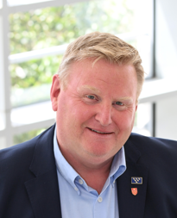
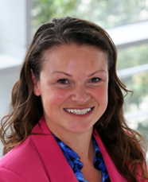
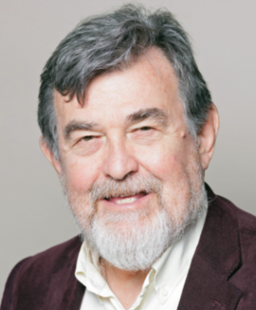
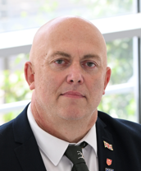
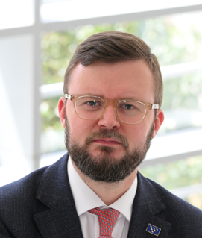
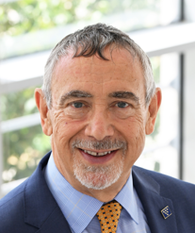
Who makes up the Board?
East Sussex County, West Sussex County and Brighton & Hove City Councils are our constituent authorities – so two senior Members sit on the Board making decisions on funding and priorities.
East Sussex County Council
Brighton & Hove City Council
West Sussex County Council
Cllr Andy Woolley
Co-Vice Chair of the SBSA
Leader of East Sussex County Council
Cllr Bella Sankey
Chair of the SBSA
Leader of Brighton & Hove City Council
Cllr Jay Mercer
Co-Vice Chair of the SBSA
Leader of West Sussex County Council
Cllr Peter Morley
Board Member of the SBSA
Deputy Leader of East Sussex County Council
Cllr Jacob Taylor
Board Member of the SBSA
Deputy Leader of Brighton & Hove City Council
Cllr Nicholas Russell
Board Member of the SBSA
Cabinet Member of West Sussex County Council
Associate Board Members
Vanessa Rowlands
Associate Member for Protected Landscape.
TBC
Chair of the Business Board as Associate Member for Business.
Ian Smith
Associate Member for Health Outcomes.

Slide 4
What does the SBSA do?
A Strategic Authority is a new regional leadership and governance body that brings together with its founding councils to look at the ‘big picture’ for the area. It doesn’t deliver resident services. The SBSA has powers and functions that cover nine core competencies.
Transport & Local Infrastructure
Skills & Employment Support
Housing & Strategic Planning
Economic Development & Regeneration
Environment & Climate Change
Health, Wellbeing & Public Service Reform (PSR)
Public Safety
Culture
Rural Affairs & Coastal Communities

Slide 5

We are SBSA...

Slide 6
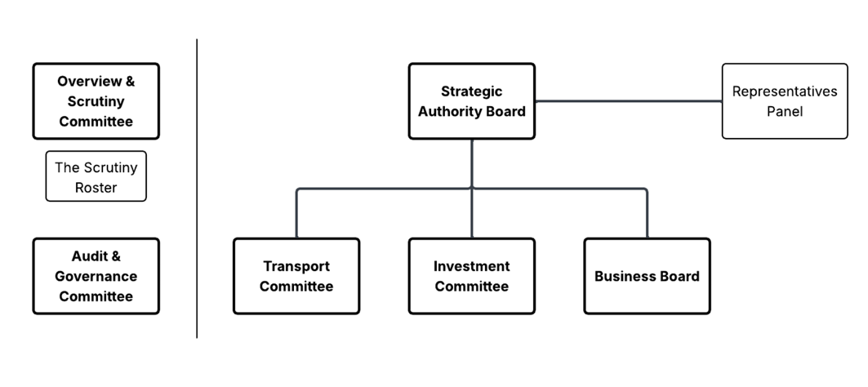
How is the SBSA governed?
The Strategic Authority is run by its Board.
The Board consists of representatives of its constituent councils who are its voting members, alongside partners and stakeholders chosen to support and inform its strategic agenda.
In May 2028, the region will be asked to elect its first Mayor. Once elected they will have their own powers and functions aside form the Board, as well as act as the Chair of the Board.
Notes:
Layout: 04 Standard content
Use a short headline and around three concise points. Use Enter for another bullet and Tab/Shift+Tab for one supporting level. Use Reset to restore the layout. Keep content brief before reducing the font size.

Slide 7
How will the SBSA deliver?
The government has granted the SBSA:
A long-term investment fund totalling £1.14 billion, and
£30.4 million over the next two years (before mayoral elections) for early investment in programmes that matter most to Sussex residents and businesses
SBSA will also receive Government funding for the functions it undertakes. The Authority is developing a Sussex & Brighton Prosperity Strategy to describe the overarching ambition and priorities as the focus for its work.
Notes:
Layout: 04 Standard content
Use a short headline and around three concise points. Use Enter for another bullet and Tab/Shift+Tab for one supporting level. Use Reset to restore the layout. Keep content brief before reducing the font size.

Slide 8
Prosperity Strategy

Slide 9
Prosperity Strategy – what, why, how, who, when?
WHAT
It’s a strategy that will set the overarching aims and objectives of the SBSA.
WHY
So we can deliver for the whole of Sussex and Brighton.
WHO
As many voices and views as we can accommodate within the resource and time we have.
HOW
Through a broad collaborative process over several stages, and by building on existing work across Sussex.
WHEN
In draft by early November and agreed by the end of the financial year / ahead of the pre-election period.
Notes:
Layout: 04 Standard content
Use a short headline and around three concise points. Use Enter for another bullet and Tab/Shift+Tab for one supporting level. Use Reset to restore the layout. Keep content brief before reducing the font size.

Slide 10
Other Priority areas of work for SBSA

Slide 11
Bus Reform Study
We are launching a Bus Reform study for the Sussex and Brighton area, following receipt of £564k from the Department for Transport for this purpose. The study will consider the full range of potential operating models and options available to improve bus services across our area, including, but not limited to, bus franchising. No decisions have been made about any future model, and the purpose of the study is to develop a robust evidence base to help inform future choices.
A key principle of this work will be engagement. We recognise the vital role that bus operators play in delivering services across Sussex and Brighton, and we are committed to working closely with you throughout the process. The study will involve extensive engagement with operators, alongside local authorities, passenger groups, stakeholders, service users and the wider public.

Slide 12
Adult Skills Funding
SBSA will become responsible for adult skills funding aimed at 19+ learners from August 2027.
Engagement is currently underway on the Adult Skills Fund Strategic Skills Plan Strategy, setting out plans on how SBSA will commission it.
Following confirmation of Plan with DWP, work will begin on implementing the Plan in early 2027.
Government has declared that further devolution will follow in relation to 14+ technical qualifications and greater control over 16-19 year old provision and employment support.

Slide 13
Spatial Development Strategy
SBSA is expected to have a legally adopted Spatial Development Strategy by end of 2029.
This would be a high level document setting out spatial ambitions for housing and infrastructure for the next 25-30 years.
To begin this process, a significant programme of evidence collection and analysis is beginning working with all 14 Local Planning Authorities in Sussex including South Downs National Park.

Slide 14
Keeping in touch with SBSA

Slide 15
Ways to keep in touch with us
  Visit our website www.sussexandbrighton-cca.gov.uk
  Sign up to newsletter by emailing enquiries@sussexandbrighton-cca.gov.uk
  Our LinkedIn: https://www.linkedin.com/company/sussex-brighton-strategic-authority
  Our Facebook: https://www.facebook.com/people/Sussex-Brighton-Strategic-Authority/61591730062083/
  Our Instagram: @sussexandbrighton

